Slide 1
EATBOT:
THE UBER EATS
CHATBOT
TEAM 8
Keani Schuller
Alisa Liu
Freddy Chen
Tashfeen Ahmed

Slide 2
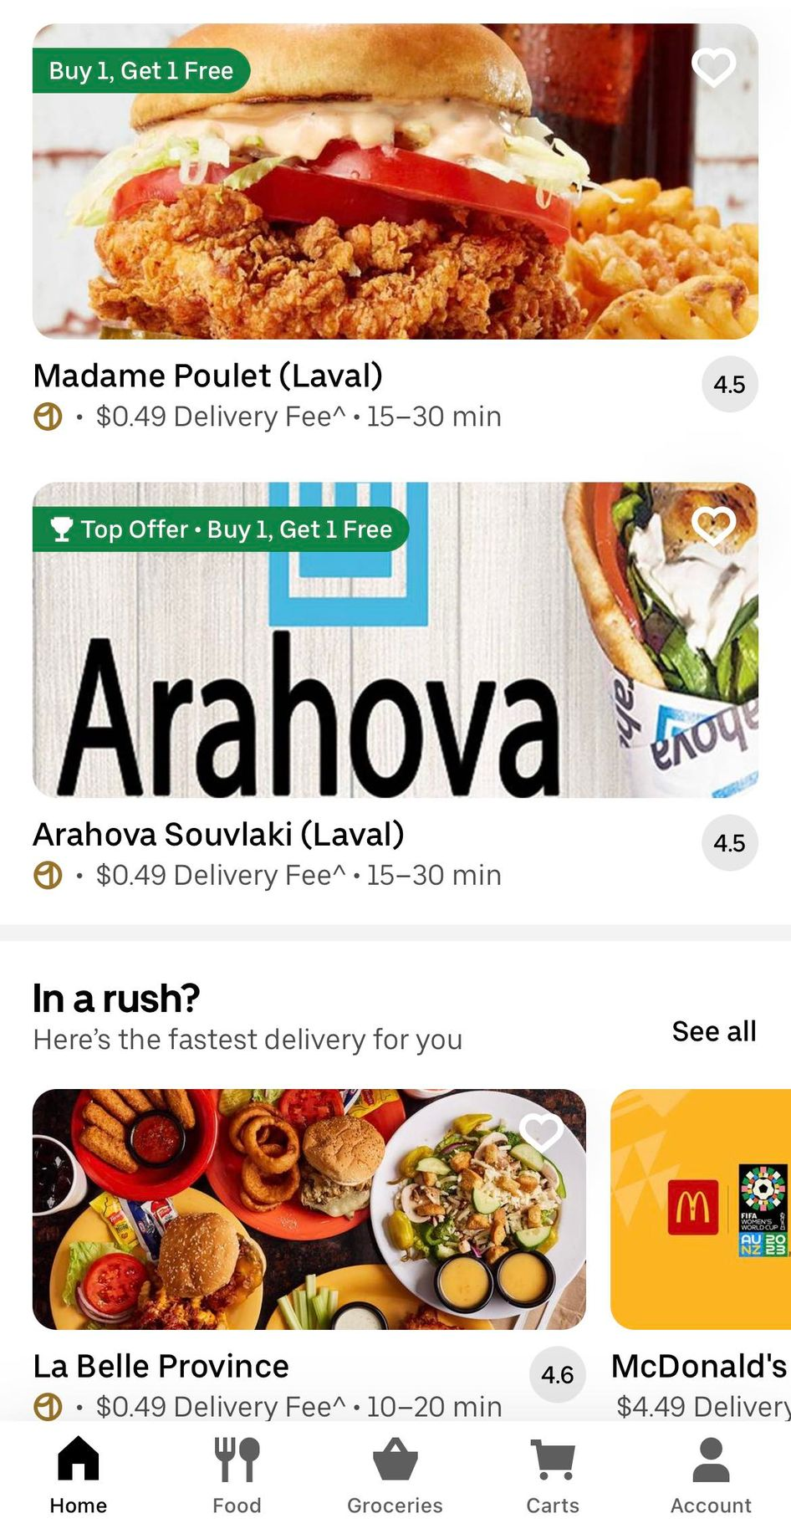
UBER EATS
The food delivery service Uber Eats is a division of Uber Technologies Inc.
Users can use Uber Eats via smartphone app or website, where they can place meal orders from a variety of restaurants and food vendors for pick up or delivery.
The online platform offers a variety of cuisines and eating alternatives, and operates in many locations throughout the globe.
Customers have the option to personalize their orders, explore menus, and follow their deliveries in real time.

Slide 3
OUR RATIONALE
EatBot aims to improve consumers’ entire experience by offering enhanced functionalities and meal delivery services on their mobile and desktop application.
Target Audience: all the users of food delivery services
EatBot will assist users while browsing menus, helping with their eating habits through data analysis and providing better customer support.
This will be offered through enhanced recommendations as well as integrating new functionalities to create competitive advantage in the food delivery service industry.

Slide 4
SCENARIOS CONSIDERED: REPLICATED
Facilitated Order Placement
Order Creation & Customization: add items to a user’s cart for them based on what they want to eat while handling order customization such as adding side dishes or choosing spice levels
Payments: It can integrate UberEats’ secure payment system for easy transactions
Enhanced Customer Support
FAQ: answer frequently asked questions about restaurants, menus, deliveries, payments, etc.
Feedback: collect feedback on the food and delivery experience from users after a completed order and register issues quicker than their current system to relate them to a support employee when needed.
User Reports: It can user data such as the total amount spent over a specified time period or top restaurants based on their order history.
UberEats

Slide 5
SCENARIOS CONSIDERED: NEW
Search and Browsing Enhancement
Image recognition: EatBot can recognize dishes from photos uploaded
Surprise meal: when the user doesn’t know what to eat, the chatbot can surprise users with a random restaurant and dish
Recommendations and Meal Planning
Recommendations: provide personalized recommendations based on preferences, moods, and so on
Suggestions: provide day/weekly meal plan based on certain criteria, such as user budget, cuisine type, calorie intake, etc.
EatsWrapped
Creating visualizations demonstrating interesting customer information
UberEats
So, what did we select?

Slide 6
LEVERAGING NEW FUNCTIONALITIES
Recommendation & Meal Plans
Image Recognition
Surprise Food Box
EatsWrapped
We decided to capitalize on enhancing current user experience by improving recommendations and adding new features within EatBot.
User can upload or provide URL of a image and the chatbot will match it to a dish on the application
Added feature based on budget, occasion, etc.
Creation of a complete surprise meal selection by the chatbot
Using customer data to create fun, shareable infographics

Slide 7
PYTHON LIBRARIES AND APIs
Pandas
Matplotlib
Clarifai API
Used pandas to create dataframes of the data ingested by the chatbot to process the data easier
Creating visualizations for EatsWrapped, demonstrating the data analysis done for the user
Connecting to general-image
-recognition & food-item
-recognition model to identify dishes

Slide 8
FUTURE CODE EXTENSION
We can add further functionalities to ask for customers’ feedback on how they think of our Chatbot services.
For example, if our information filter is accurate enough to meet customers’ satisfaction
Consider precise location of users to calculate expected delivery time

Slide 9
HOW EATBOT WILL BENEFIT UBEREATS
EatBot stays within UberEats’ core business and branding
It enhances the current customer experience through its new features that still align with current UberEats
For example, by creating meal plans, EatBot transforms the limited filtering options that leaves everything up to the user, to creating detailed and tailored plans with little to no effort from the user
Each new feature is a simple but effective way to leverage Uber’s massive amounts of data to give users the impression that they are getting superior service on UberEats
EatBot will allow UberEats to capture more market share and generate a competitive advantage over other delivery apps by demonstrating differentiation
This will in turn allow for increased sales and profitability

Slide 10
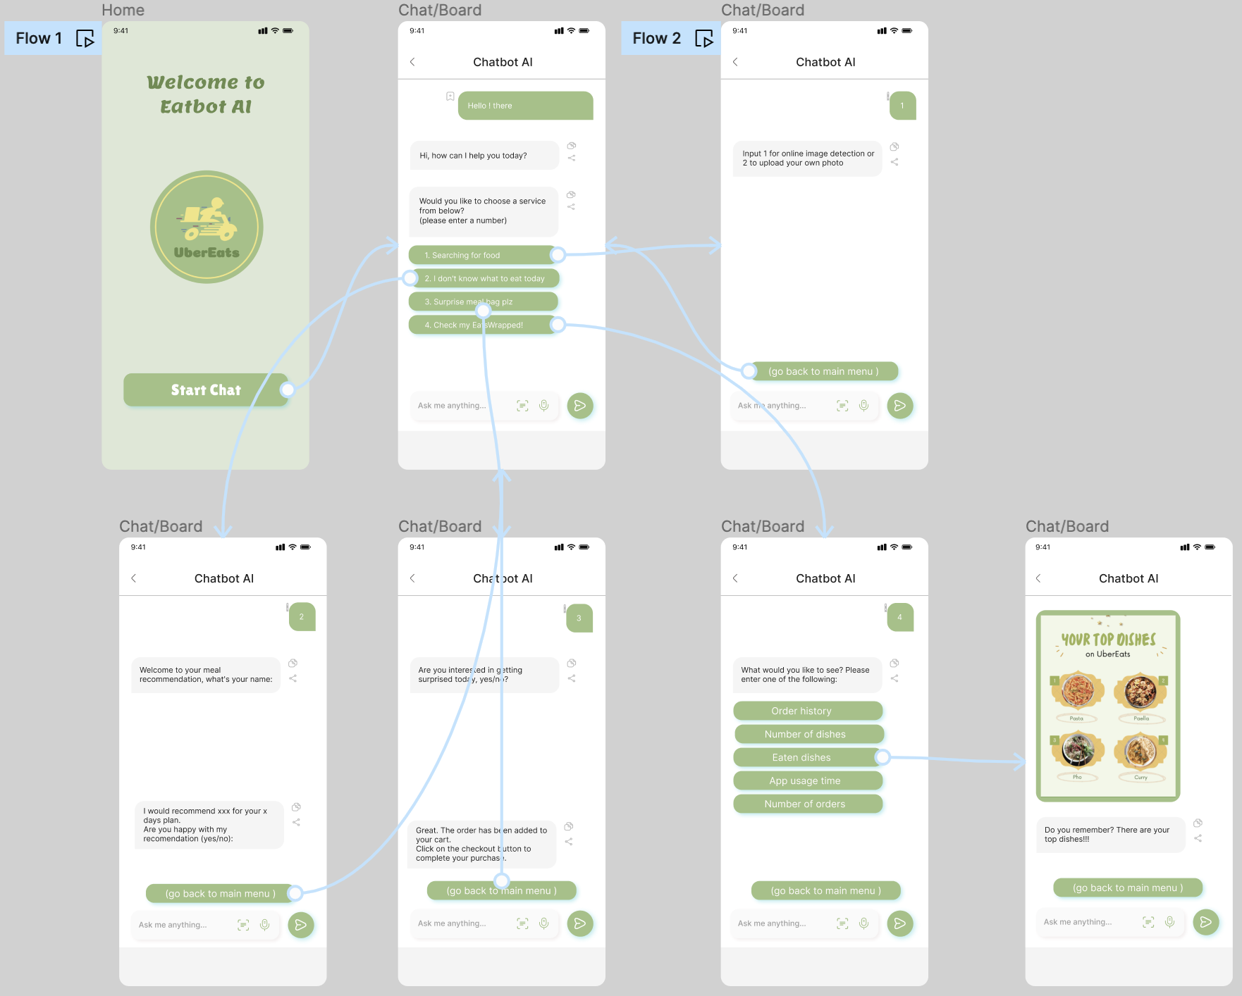
EXAMPLE USER INTERFACE

Slide 11
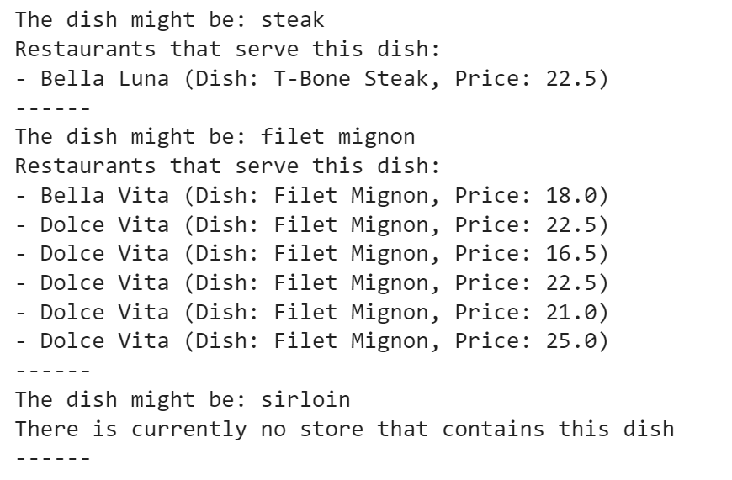
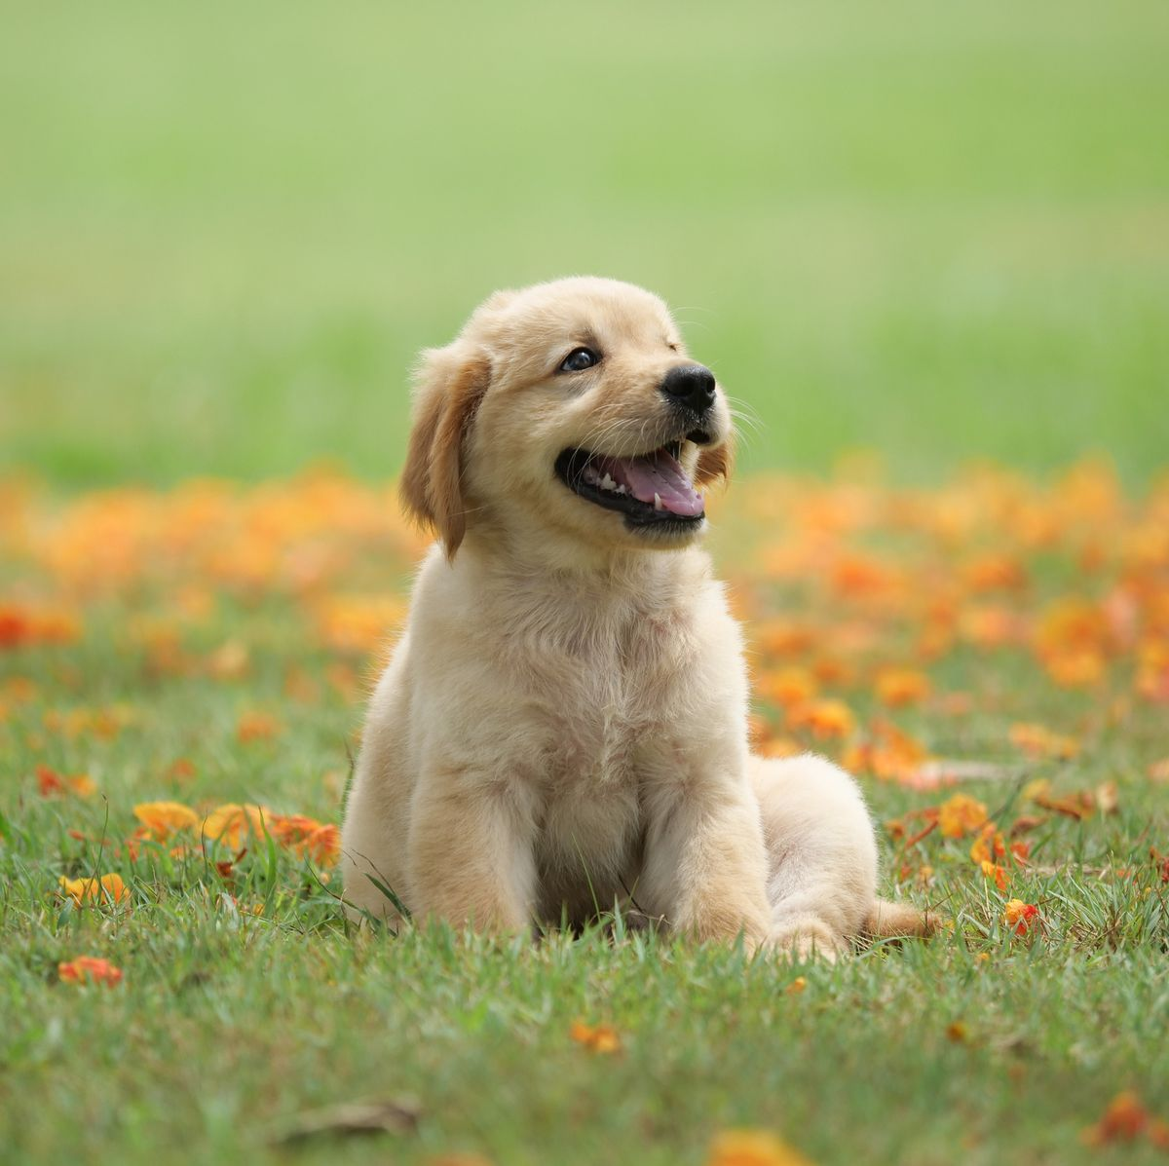
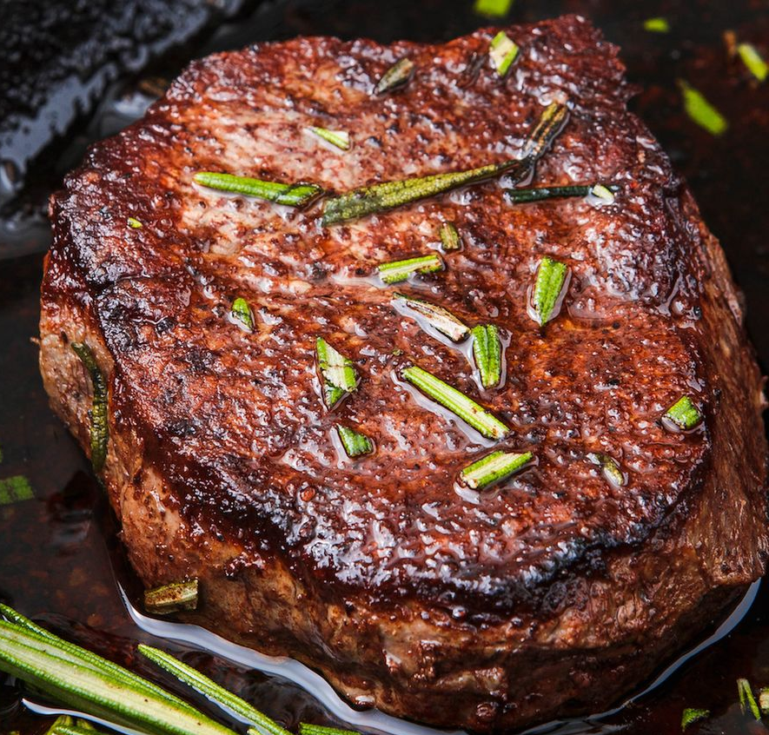


FOOD RECOGNITION: New Scenario
• Use general-image-recognition model to detect
food-related elements
• If there isn’t any food-related words, return the key
elements revealed in the image
• Use food-item-recognition model to identify the
Dish if certain keywords are detected
• Match the identified dish name to the restaurant
dataset to find restaurants that have this dish
• Return the top three possible dishe names, prices,
and the relevant restaurants

Slide 12
MEAL RECOMMENDATIONS & PLANNING: New Scenario
Problems: Uber Eats has a relatively limited filter option; customers always get struggled on what to eat from too many choices
We use Chatbot to extend the filters to further narrow down customers’ choices and make recommendations based on their inputs such as budget.
We also have the function of meal planning by ask customers to input how many meals they want to be recommended.
Code: used Pandas library to read the mock data file and filter qualified restaurant based on customers’ input for parameters
Parameters taken into consideration:
Budget, occasion, restaurant type (NOT want to eat for sure), maximum waiting time expected, minimum rating expected, and number of meals wanted to be recommended

Slide 13

SURPRISE FOOD: New Scenario
Inspired by Too Good To Go app
If the user wants to get surprised EatBot can surprise them by recommending a restaurant and its dish
EatBot starts by asking user if they want to get surprised if they say yes a recommendation given
If the user accepts it, then the dish added to the cart; otherwise another recommendation is given (see Appendix 2)
This functionality is not included in UberEats yet
Some customers struggle with the amount of choice available on Uber Eats
It will help customers to try new dishes and increase revenues for the company

Slide 14
SURPRISE FOOD: New Scenario
Python Libraries Used
1. ‘random’: Generates random values and selections for variety in the code's decision-making process (see Appendix 3)
2. `CSV`: Handles reading and writing CSV files, facilitating data processing from and to structured tables (see Appendix 4)
The `random` library adds diversity to UberEats by enabling random dish and restaurant selections for surprise meals, while the `csv` library facilitates organized storage and retrieval of restaurant data for efficient service.

Slide 15
EATS WRAPPED: New Scenario
Currently, UberEats doesn’t allow users to view insights on their data
Inspired by Spotify’s “Spotify Wrapped” and Apple Music’s “Rewind”
UberEats generates massive amounts of data that isn’t leveraged to its full potential
Allowing users to see their UberEats data in a fun and interesting way and be able to share it with others will:
Attract more consumers to the platform through word-of-mouth and posts online
Entice current users to interact more with the application over other delivery services

Slide 16
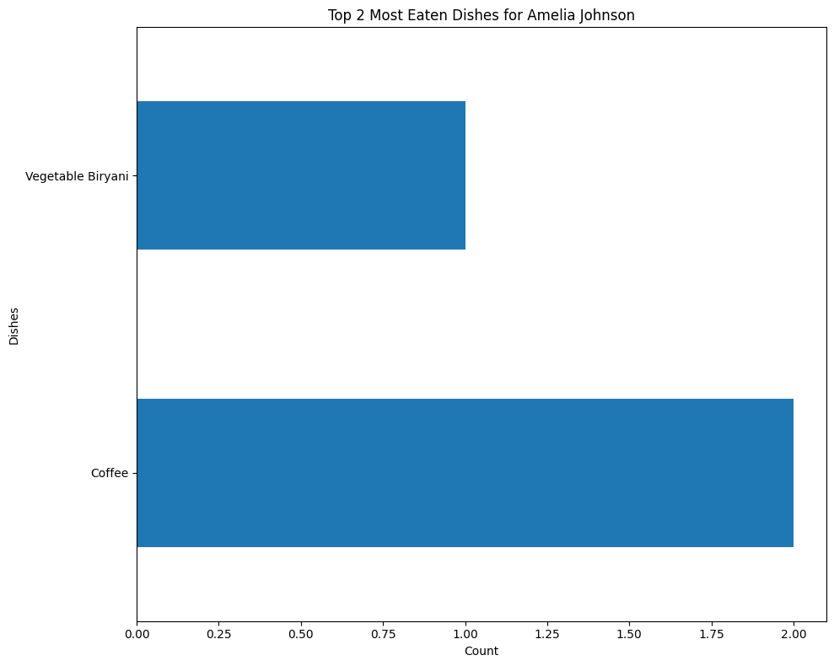
EXAMPLE 1
User’s Top Dishes
Using matplotlib, EatBot provides a visualization of the user’s current top dishes when prompted or when asked to generate a user’s Eats Wrapped (see Appendix 5)
Theses visualizations, with the right graphic design and marketing team, can become fun infographics that users can share with friends or on social media

Slide 17
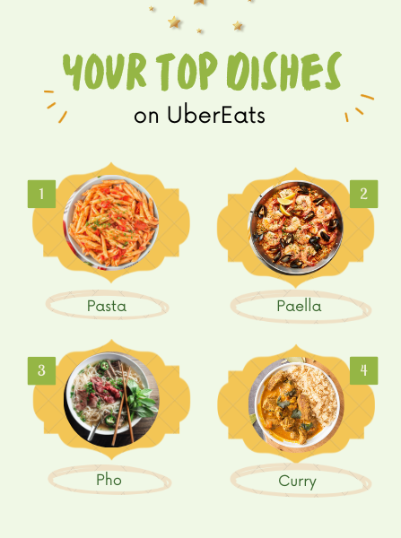
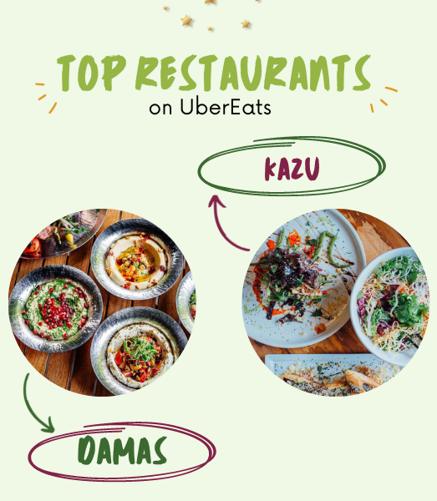
SHAREABLE INFOGRAPHIC EXAMPLES

Slide 18
Thank You!
Any Questions?

Slide 19
APPENDIX
From our proposal, we considered four different scenarios including: UberEats Browsing, Meal Planning, Order Placement, and Customer Support. Since there topics are too broad and can contain millions of sub parts under each, we choose to select only one or two scenarios from our original brainstorm and expand them to be our new four scenarios for final submission.

Slide 20
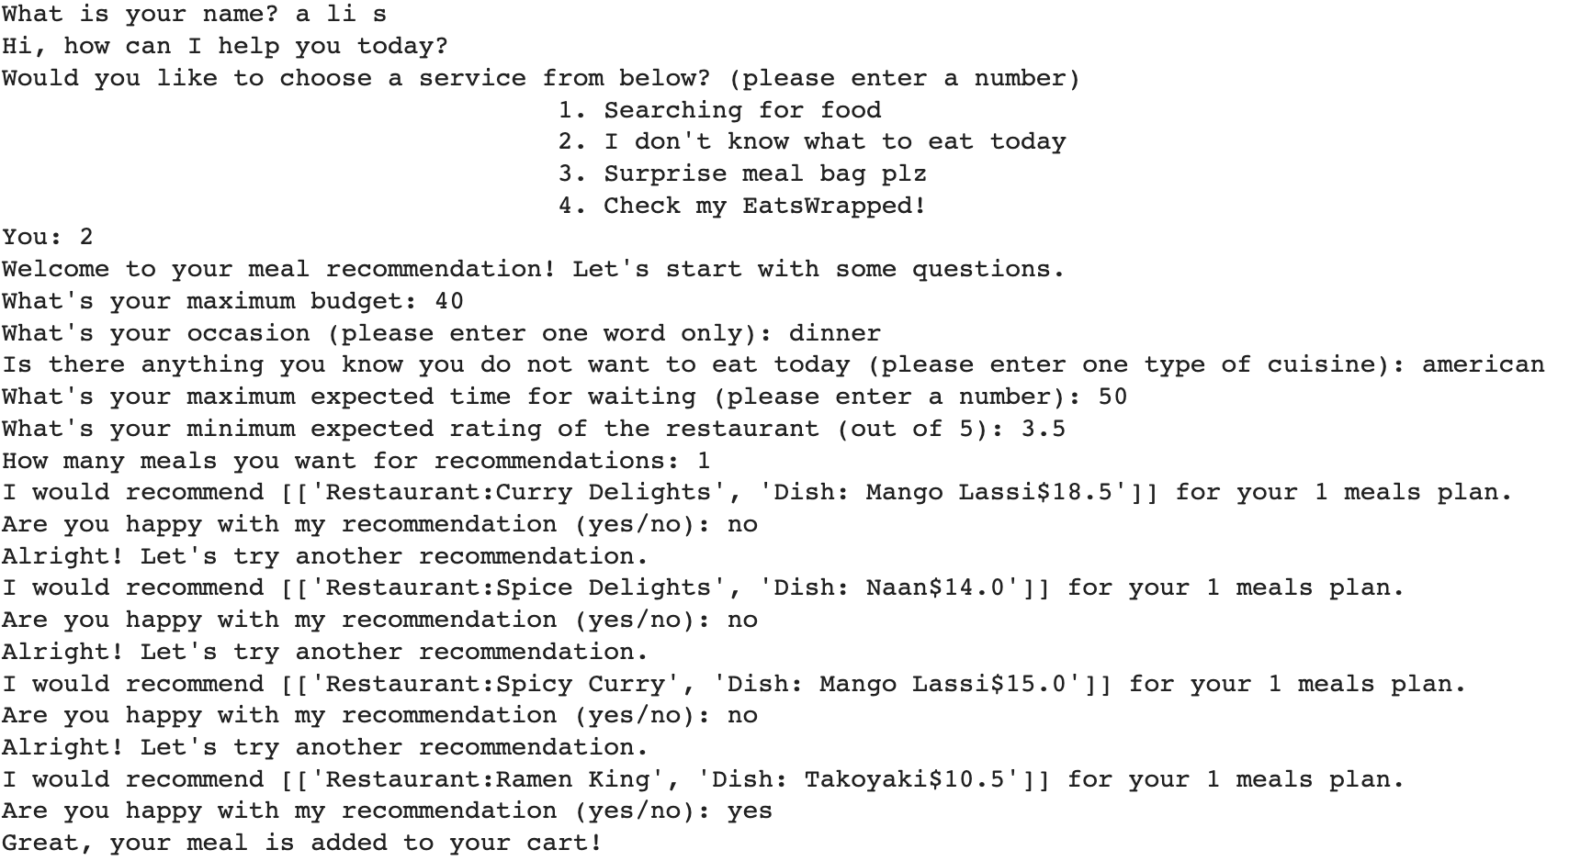
Appendix 1: Meal Recommendation Sample Output

Slide 21
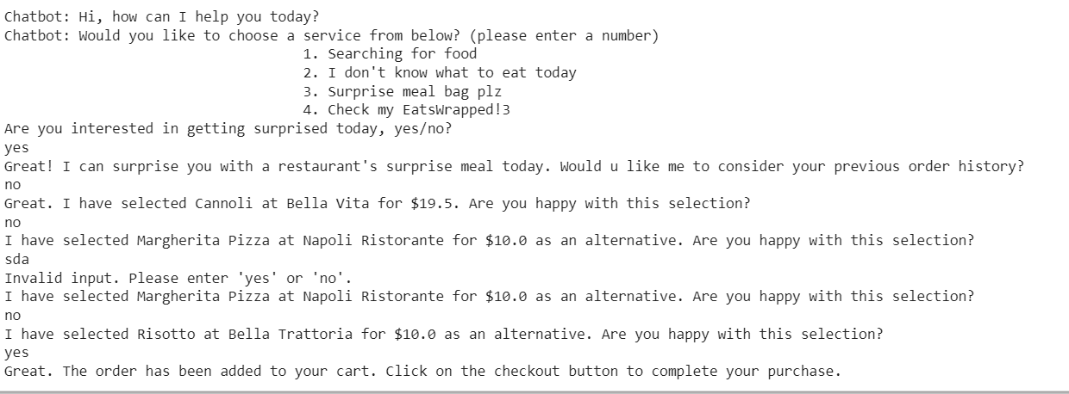
Appendix 2: Surprise Food Sample Conversation

Slide 22
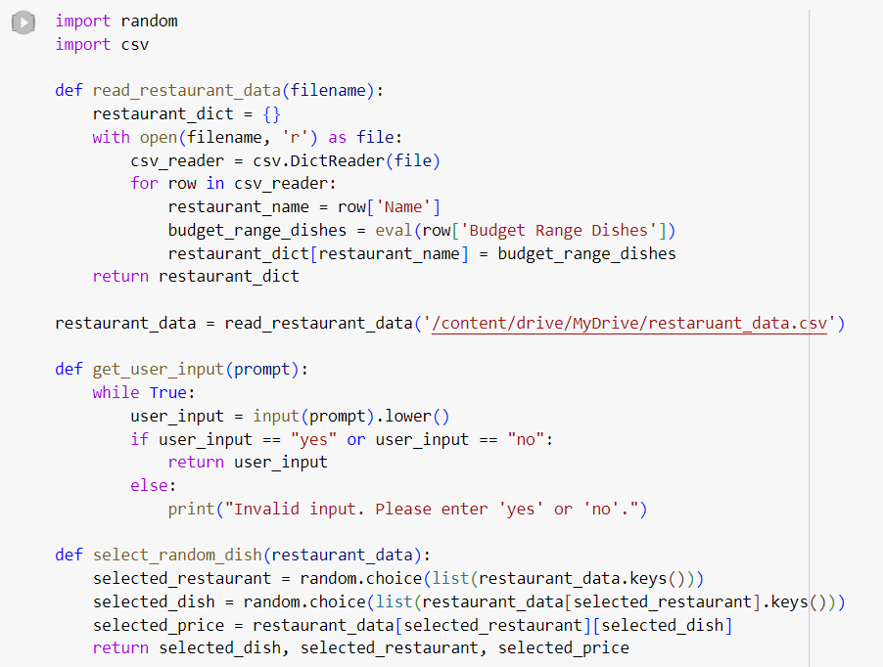
Appendix 3: Surprise Food Import Random & CSV

Slide 23
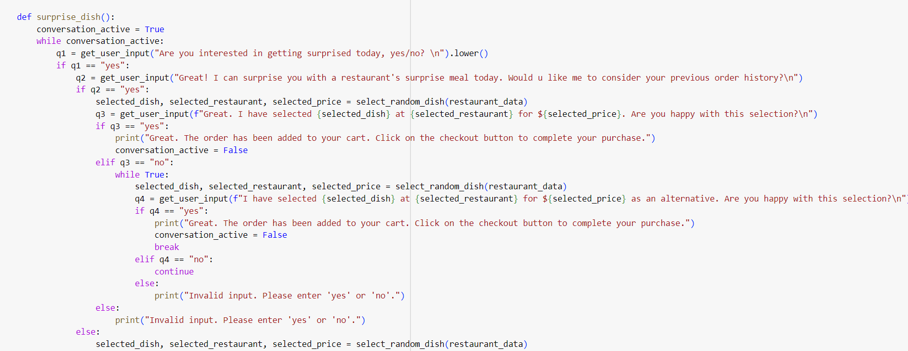
Appendix 4: Surprise Food Function

Slide 24
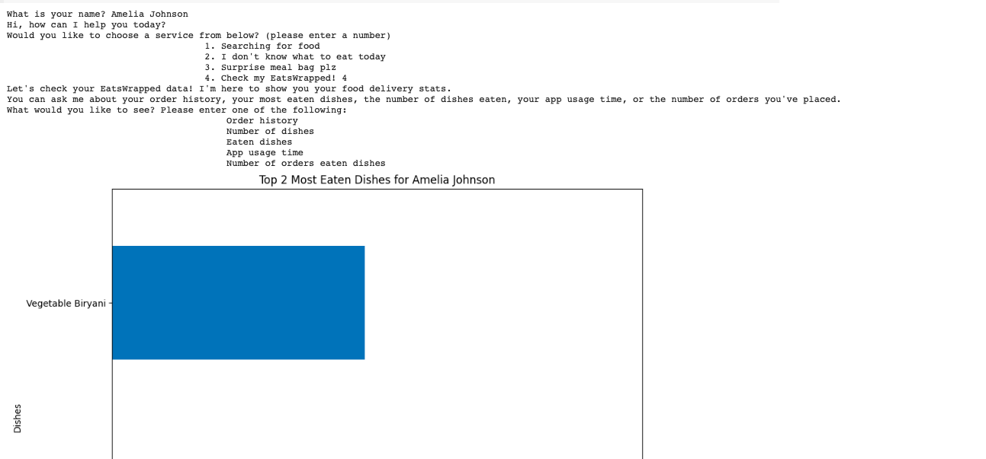
Appendix 5: EatsWrapped Chabot Sample Output

